Slide 1
XPLAN REPORTING webinar
20 November 2024
INGRID sCHWABROW

Slide 2
Agenda
Creating a client list
Explain the different Report Types in Xplan
Export data
Management reports
Merge Reports
Xport
How to generate the different reports
Example Reports available

Slide 3

Client list
    In Xplan, reports are generated on a list of clients in your search result. Depending on what report you are running you may need to:
      Running reports on a Full list of clients
      Selecting a few clients from the search result
      Using a search criteria or advance search

Slide 4
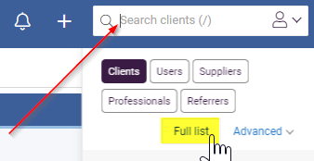
Client list
      Full list of clients
      Navigate to the top right-hand corner of your screen
      Click into Search Client
      Ensure Clients is highlighted
      Select Full list

Slide 5
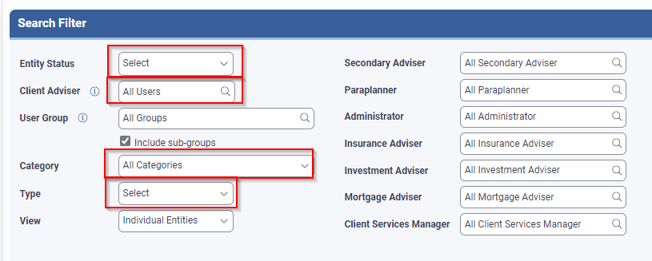
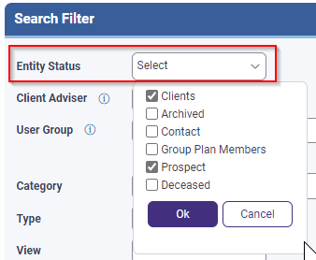
Client list
      This will produce a full list of all your clients
      The Search Filter section allows you to narrow your list of clients by using the drop down or search function against certain fields.
      Filtering on Entity Status is a good way to narrow your list as you may not need to include Archived or Deceased.

Slide 6
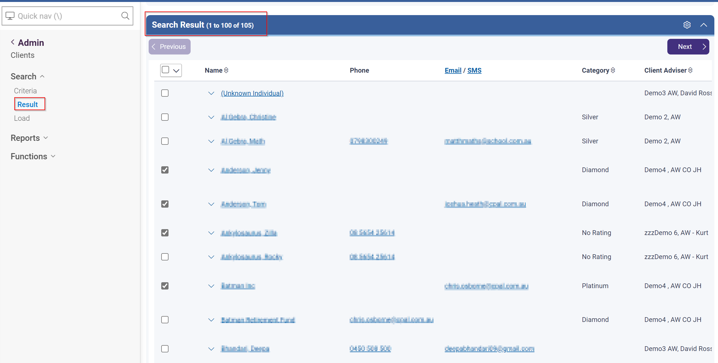
Client list
      Selecting a few clients from the search result
      Once you have a Full list of clients you can select just a few clients by clicking the box next to the clients' names.
      Under the report functions there will be an option to select
      Only Selected Clients
      TIP:
      We recommend using this option when running a test run for a report that you run for the first time. This will allow the report to run quicker.

Slide 7
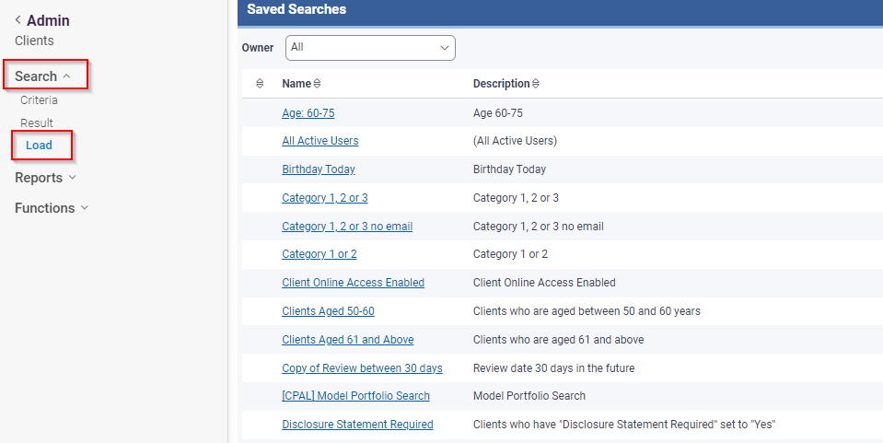
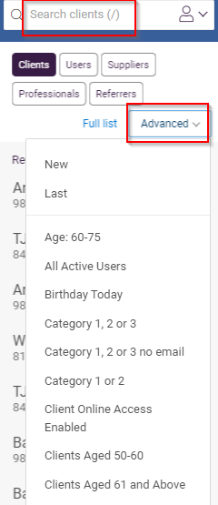
Client list
Creating a Client List using a Search Criteria or Advance Search.
Our site already has numerous Advance searches set up, which you can run.
      Navigate to the top right-hand corner of your screen
      Click into Search Client
      Select Advanced
.
When you have a list of clients, you will see on the left-hand side menu option:
Search > Load
This will give you the list of Advance Searches available to you

Slide 8
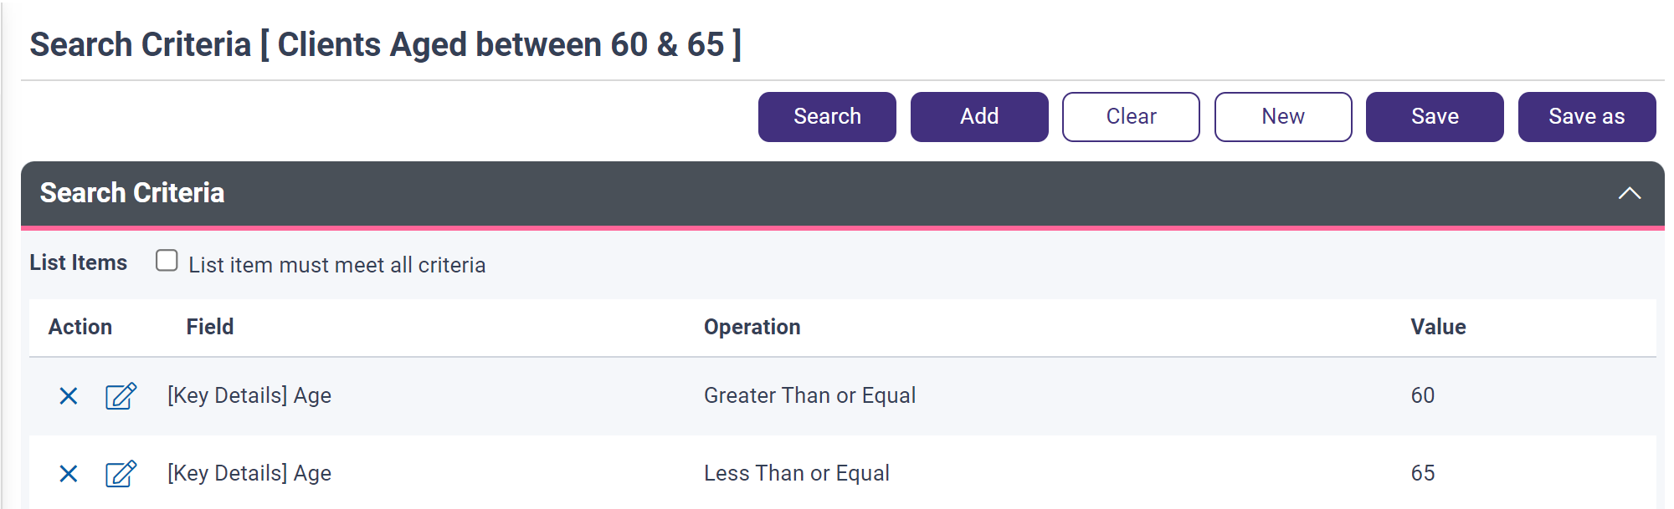
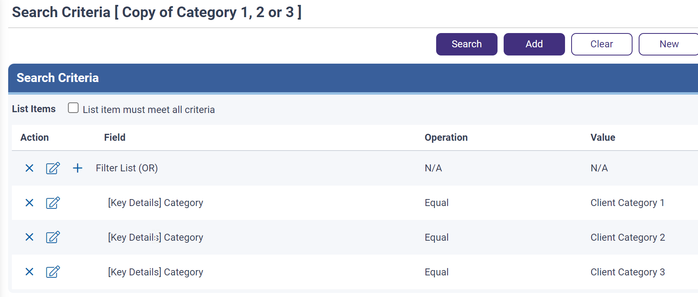
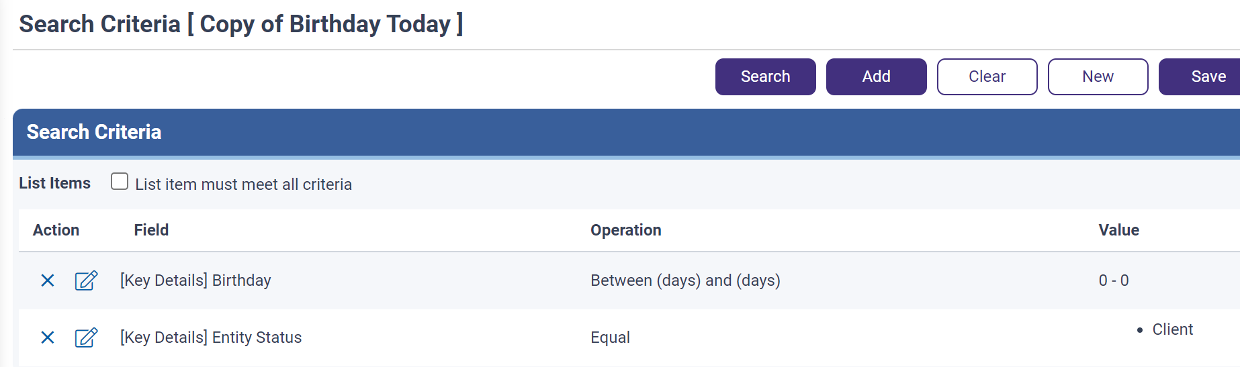
Client list
Here we have some examples of already created Advance Searches
Clients Age 60-65
Category 1, 2 or 3 uses selected Clients Category
Client’s Birthday is today

Slide 9
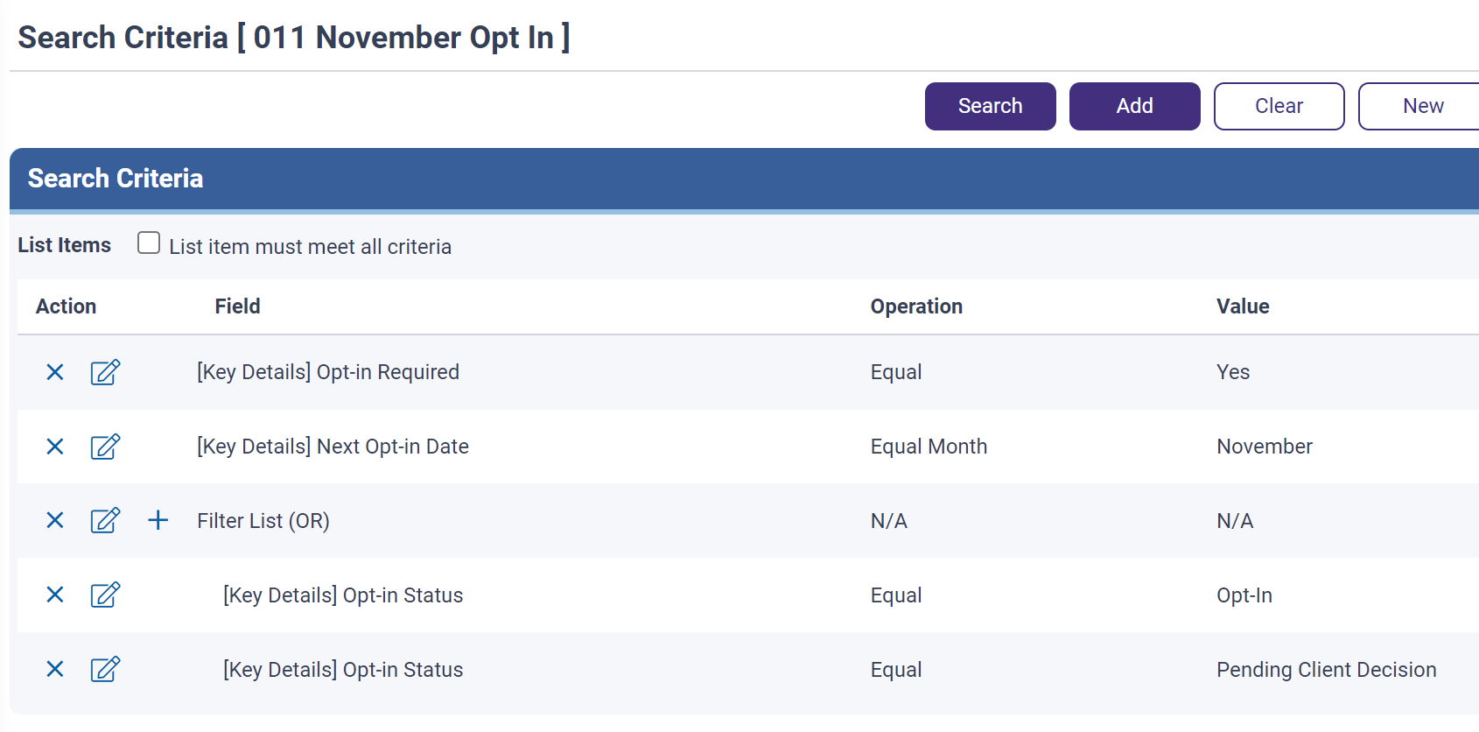
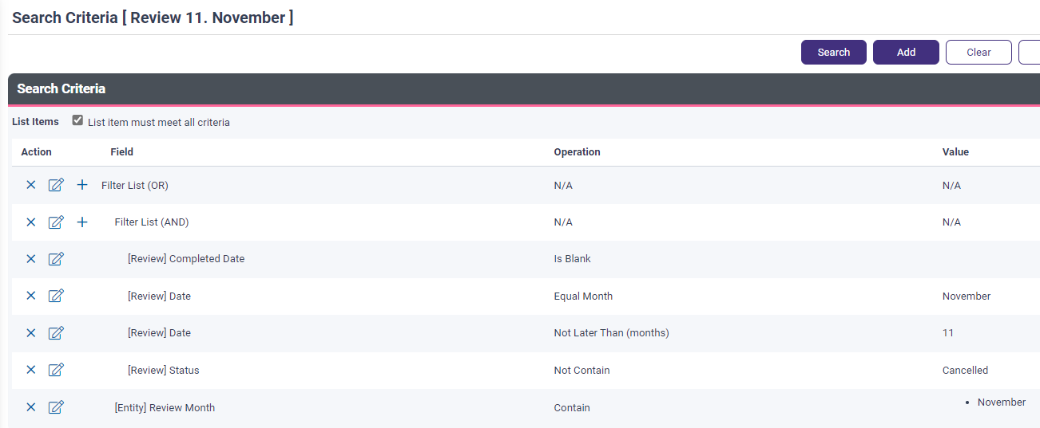
Client list
Here we have some more examples of already created Advance Searches which are a bit more complex
Clients that have Opt-in’s due in November
Clients with a Review due in November
    Advanced Search | How do I create a new Advanced Search Criteria? | Centrepoint Alliance Technology Solutions

Slide 10

different Report Types in Xplan
  Export Data Reports
  Simple client data can be easily exported in CSV files
  Management Reports
  Standard Xplan reports covering various reporting areas
  Limited customisation
  Merge Reports
  Uses Xplan coding
  Provides greater flexibility in report layout, format and types of data being reported on
  Xport Reports
  Large amounts of data from a range of data sources can be extracted
  Layout of the report is customisable

Slide 11
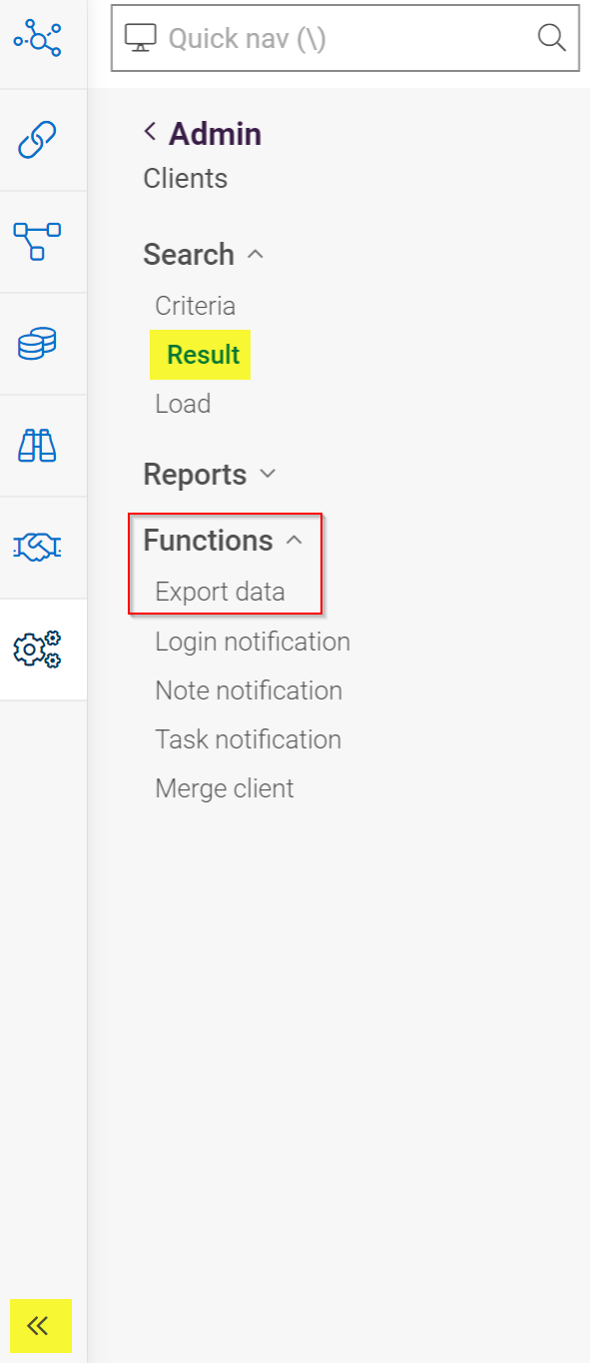
EXPORT DATA reports
    Once you have your Client List under Result -
    Navigate to the left-hand menu and select Functions > Export data
    If you don’t see these options, use the arrows at the bottom of your screen to make these options visible.
    We refer to these reports as Simple export of data reports that you can create yourself selecting certain fields.

Slide 12
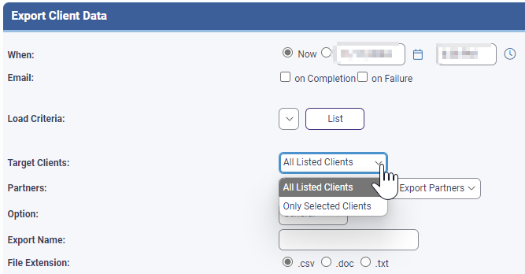
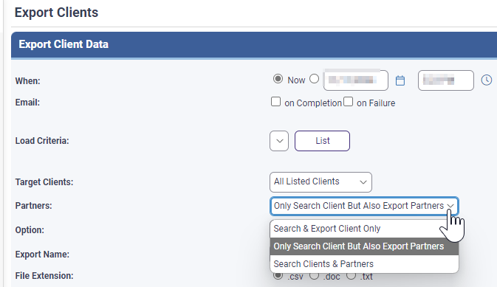
export Data reports – Report Options
    Under Target Clients you can select
      All Listed Clients or
      Only Selected Clients
    Partners gives you the option of how you wish to see the client in the report
    Search & Export Client Only – will only report out on the Client entity
    Only Search Client But Also Export Partners – will report out both and the partner will be displayed to the right of the client
    Search Clients & Partners – will generate a list of all clients in a single column

Slide 13
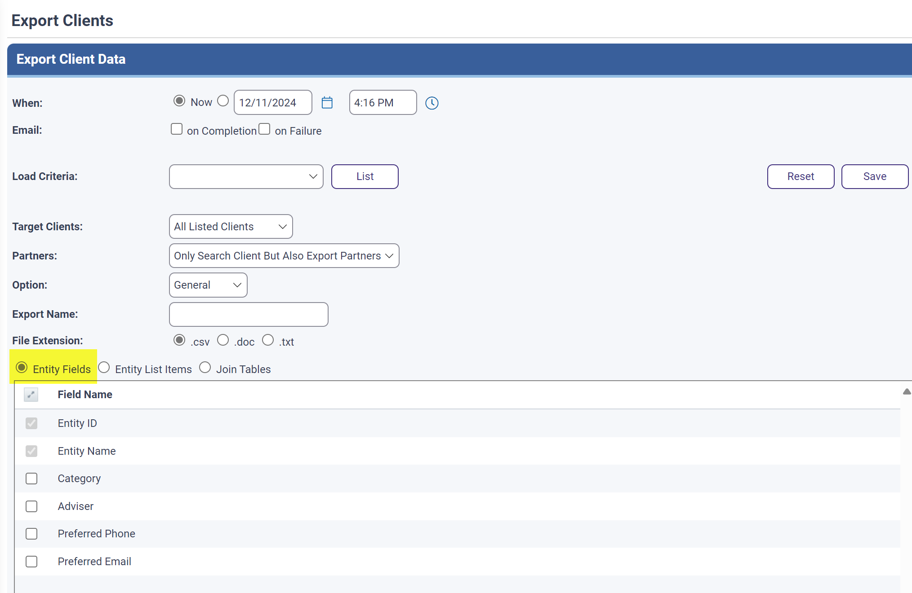
EXPORT Data reports
    Under the Entity Fields is where you select the fields you would like to have included in your report.

Slide 14
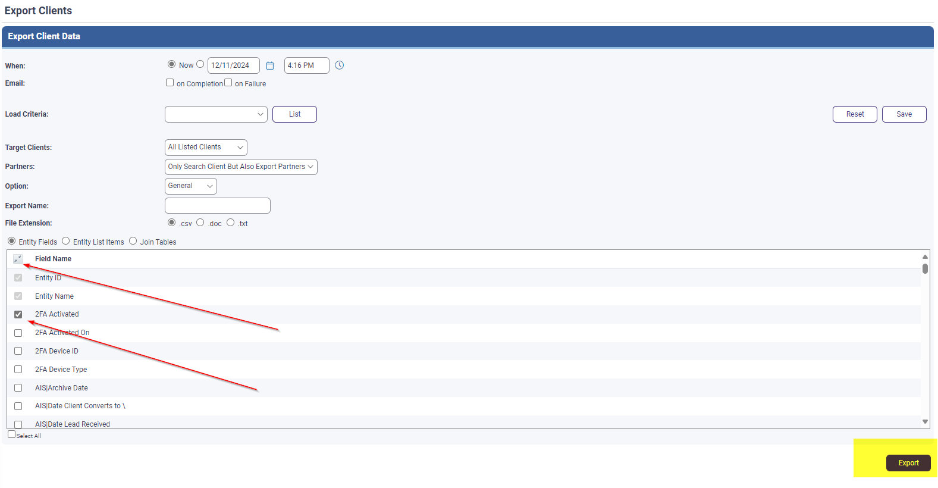
EXPORT reports
    You can extend the selection by using the expand button next to Field Name to list all the fields against a client you can extract.
    Simply click in the box against the field you wish to include and select Export in the bottom right-hand corner.

Slide 15
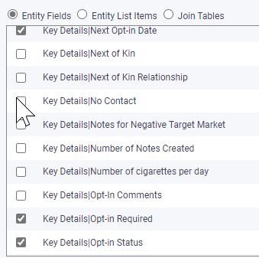
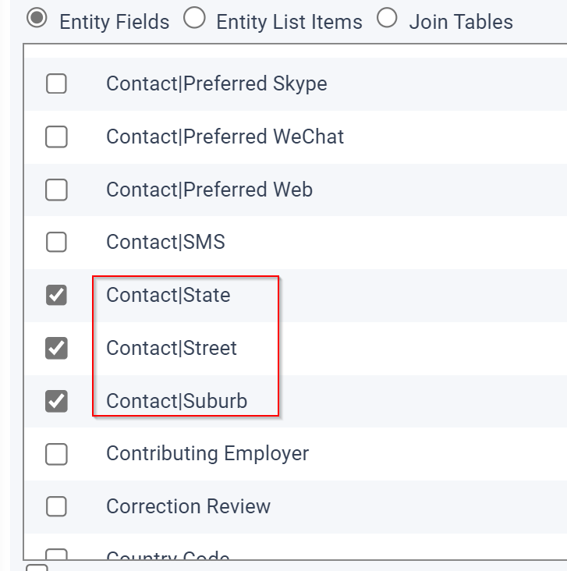
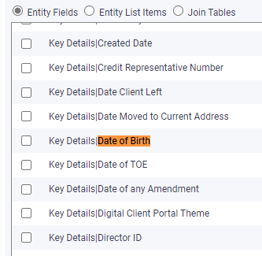
EXPORT reports
    Here are some examples of single fields that can be select.
    Ctrl+F can be used to help search a particular fields.
    Note: the downside to these reports is that a separate spreadsheet is created for entity, company, partnership, superfund and trust.
    Export | Exporting Client Data from Xplan | Centrepoint Alliance Technology Solutions

Slide 16

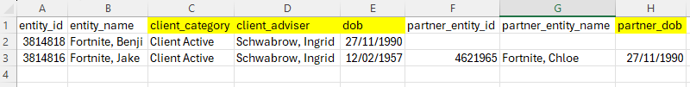
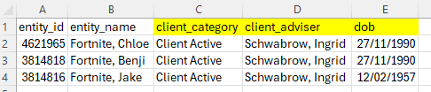
EXPORT reports
    Here are some examples of a how the client data is Exported using the same 3 Clients and selecting the same 3 fields
    Client category
    Client Adviser &
    Date of birth
Partners Option:
Search & Export Client Only
Only Search Client But Also Export Partner
Search Clients & Partners

Slide 17
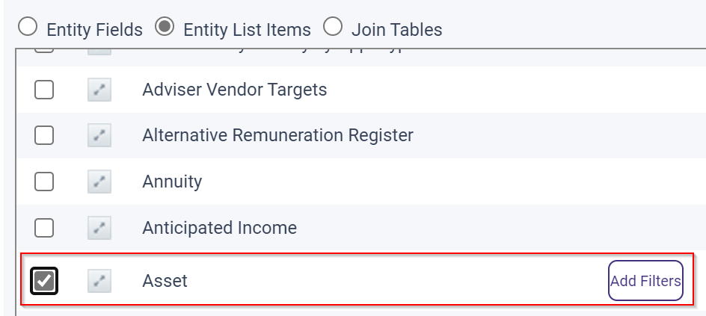
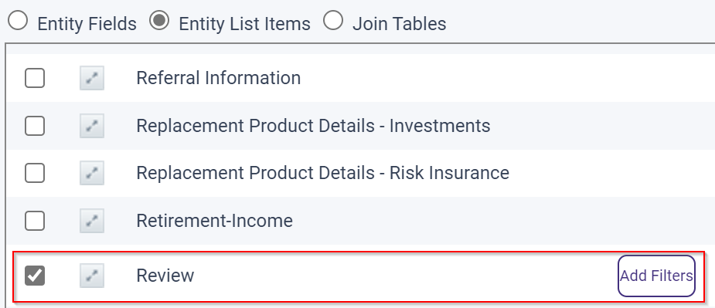
EXPORT reports
    Here are some examples of group fields that can be select under Entity List Items.
    You can add an extra filter option once you have selected a field. This is a bit more complex, and the below guide walks you through an example of searching a Platform under Asset.
    How do I search Client Linked Platforms | Centrepoint Alliance Technology Solutions

Slide 18
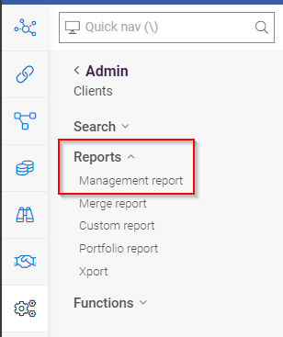
Management report
From the left-hand menu navigate to Reports > Management report
Reports here are standard pre-built reports that have been created by Xplan.
There is a wide range available for selection.

Slide 19
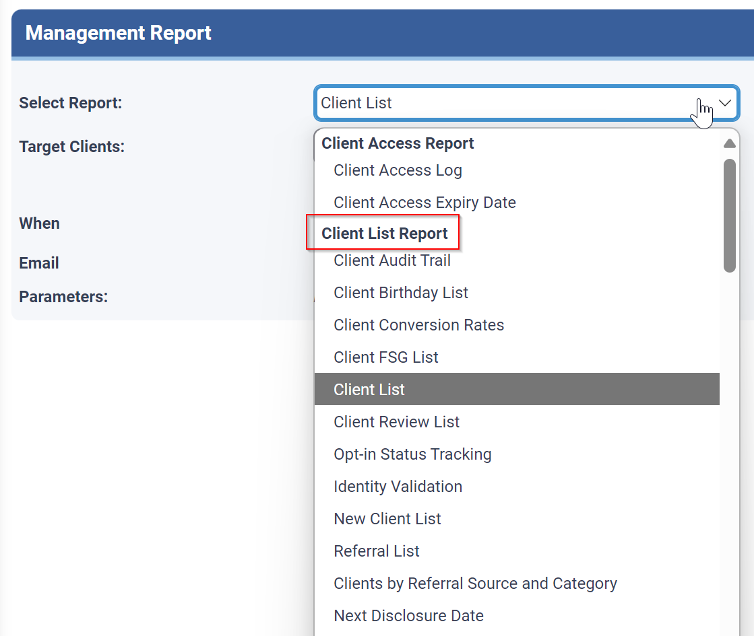
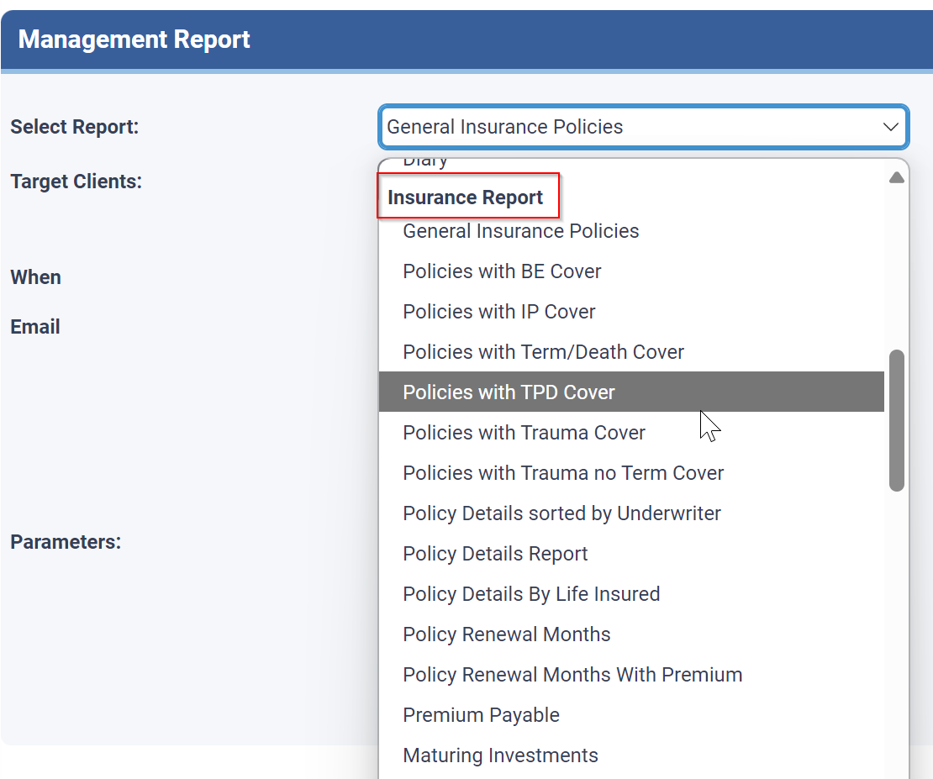
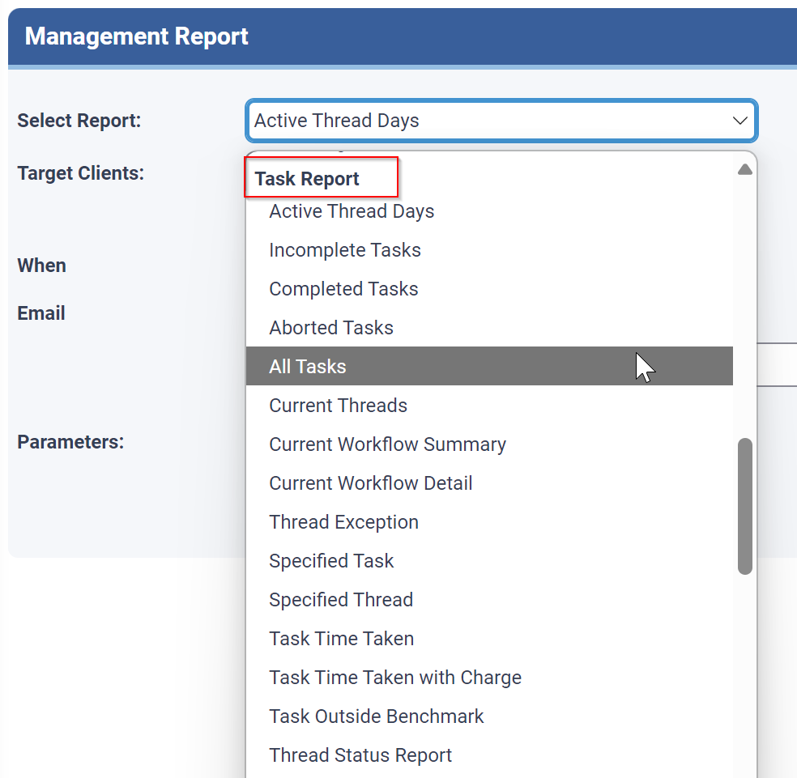
Management report
Some Report Selections are
Client List Report
Insurance Report
Task Report

Slide 20
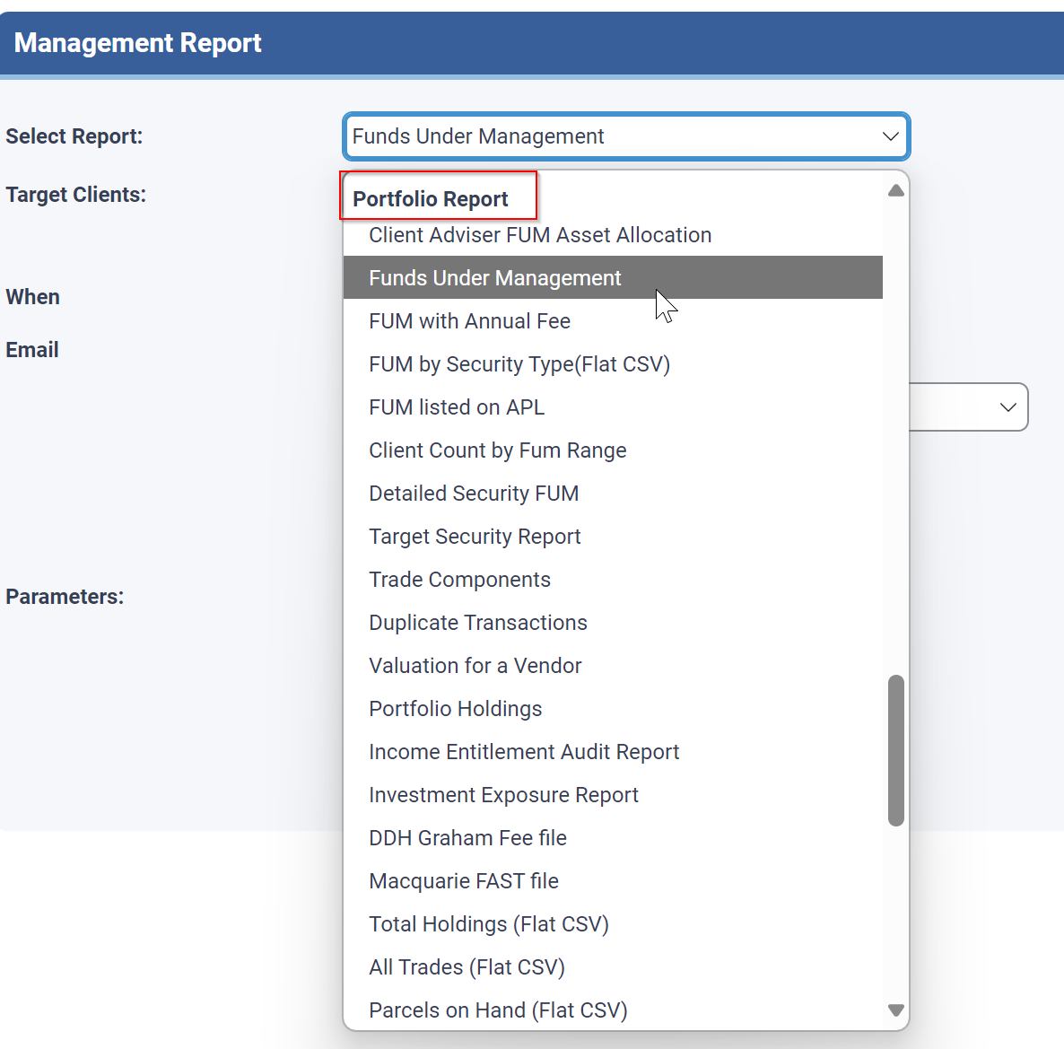
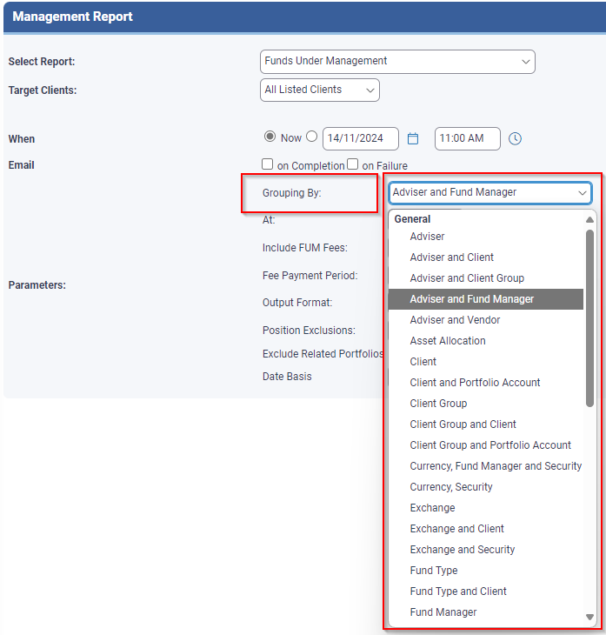
Management report
Each report will have different parameters.
In this example the Portfolio Reports are newer reports and have multiple parameters (IPS License required)
If you select Funds Under Management, you have the parameter of Grouping by.

Slide 21
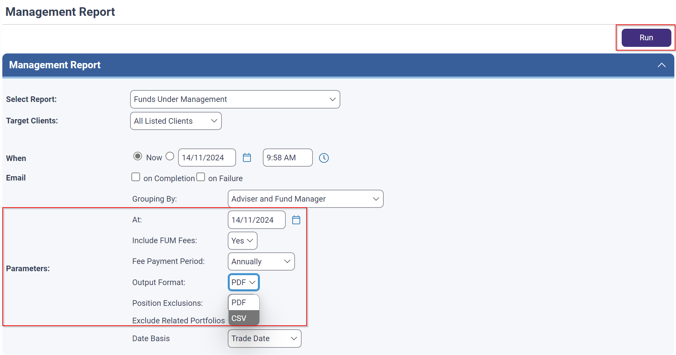
Management report
The following parameter are also options
At date
Include FUM Fees,
Fee Payment Period and
Output Format.
Select Run from the top right corner.
Generated reports appear in the bell icon.

Slide 22
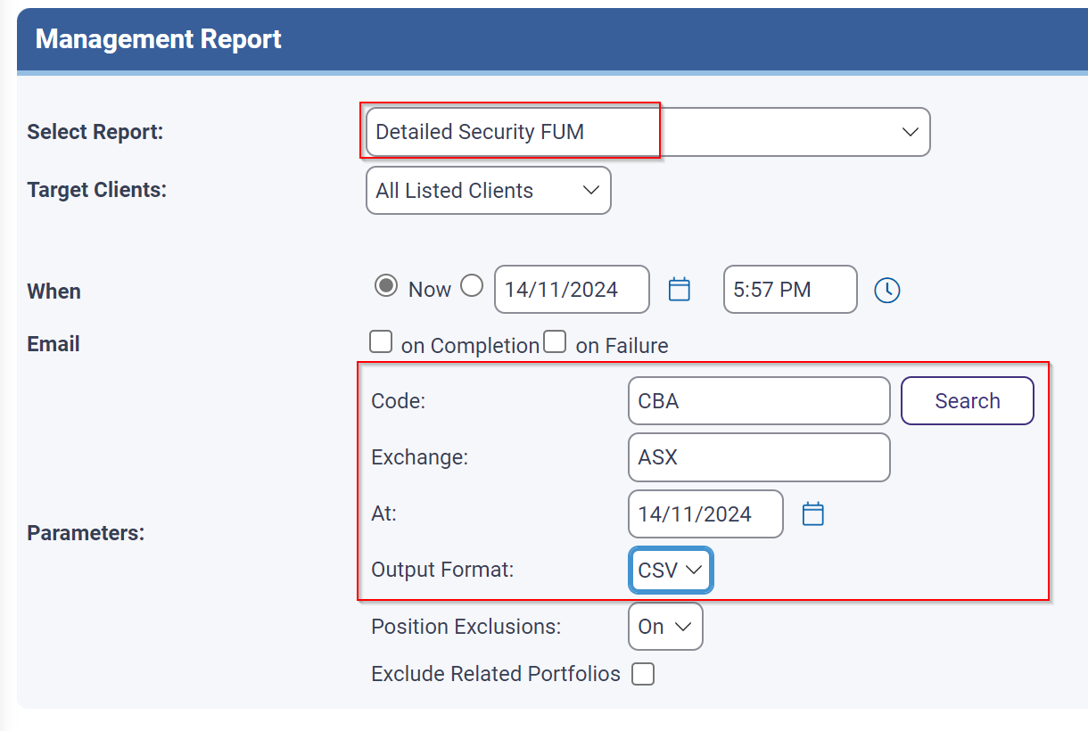
Management report
In this example the Portfolio Reports > Detailed Security FUM
Allows you to generate a report of clients who hold a particular security and value accordingly. The following parameter are also options
Security Code
Exchange
At date
Output Format.
Select Run from the top right corner.
Report | How do I run a Management Report? | Centrepoint Alliance Technology Solutions

Slide 23
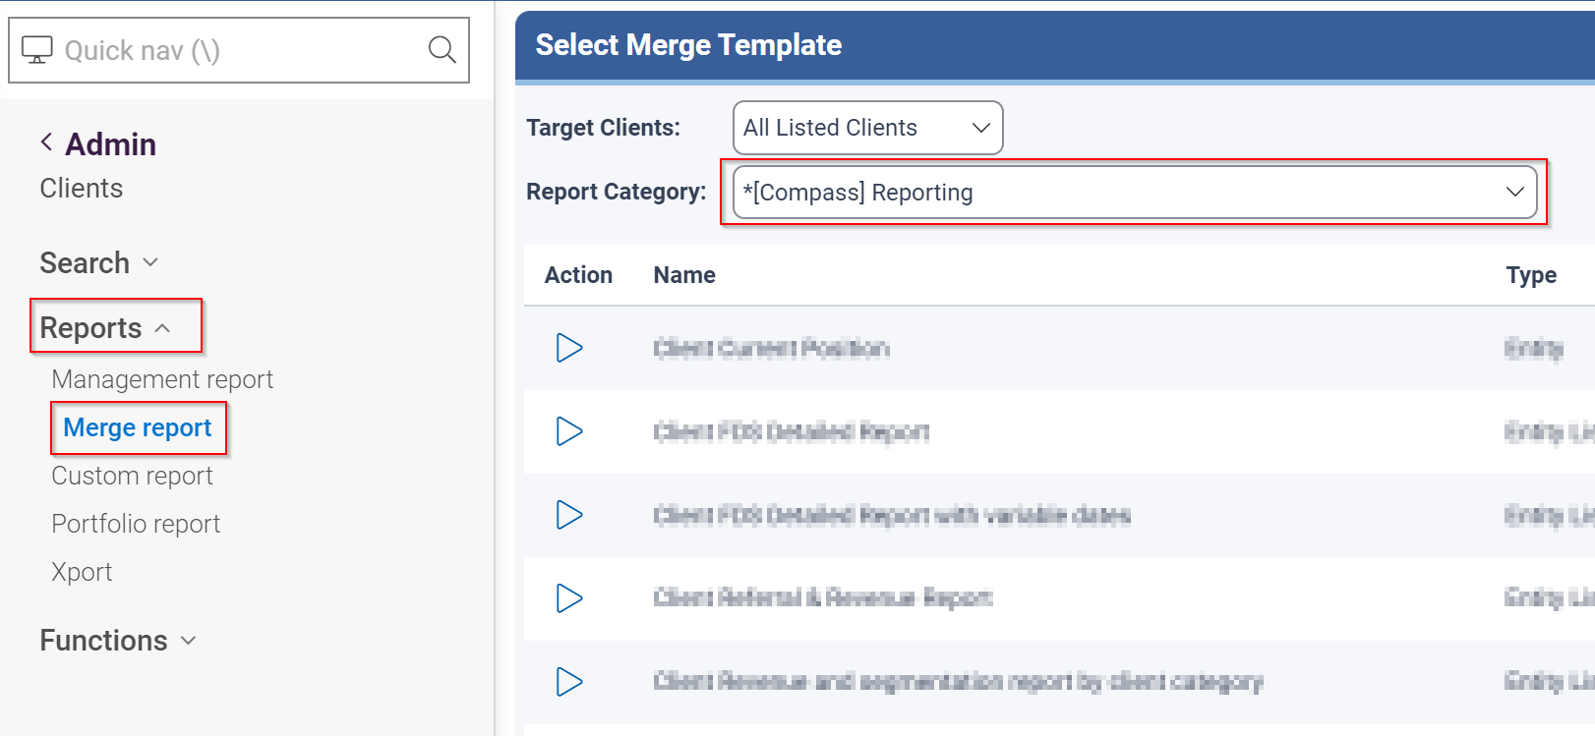
Merge reports
    The reports available from the Reports > Merge Report > *[Compass] or CWT Reporting are templates that have been created internally. They are heavily coded and pull data from different areas of Xplan into a formatted excel report.
    You may have other reports that your practice has created, and they will sit under Report Category: [Practice Name]

Slide 24
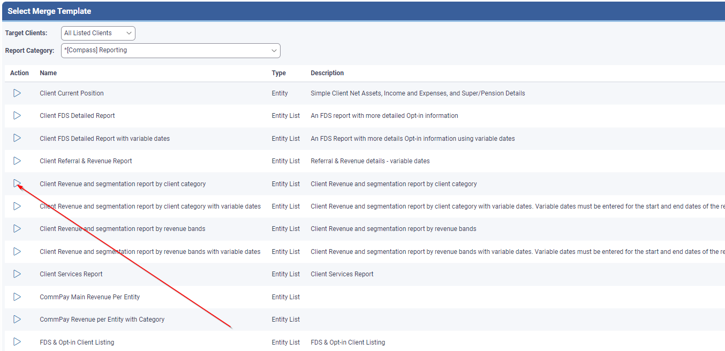
Merge reports
    To run a Merge report simply select the arrow under Action against the report you wish to run.

Slide 25
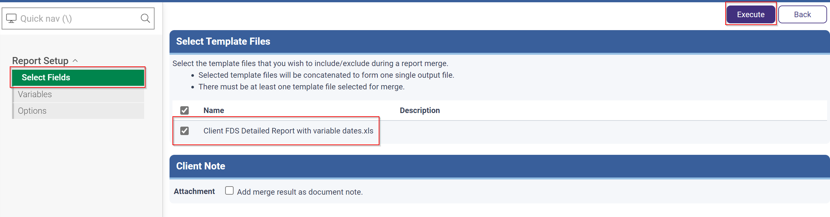
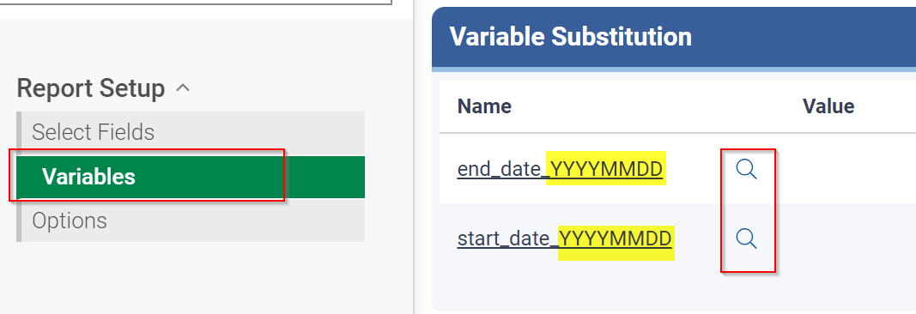

Merge reports
    Under Select Field will show you the report you are about to run.
    Then select Execute in the top right-hand corner.
    Some reports require a Variable option that allows a particular date range to be selected.
    Date needs to be entered YYYYMMDD
    Use the to enter the Value

Slide 26
Merge Reports
    Here are some examples of commonly run reports. Until you find the report you would like to use, we recommend only selecting a few clients to allow the report to run faster
Client Segmentation Report Guide | Centrepoint Alliance Technology Solutions
Tip:
If you are manually updating offline spreadsheets, please have a chat with us, as our Enzumo team may be able to create a custom report for you. The cost versus the benefit could make it a very viable solution moving forward for your practice.

Slide 27
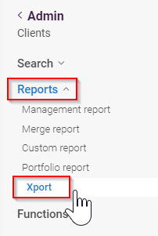
Reports > xport
    Xport reports are available under Reports > Xport
    Large amounts of data can be extracted from a range of data sources
      Clients, DocNotes, Tasks
    Content of the report is customisable.
    You do require special capabilities to run these reports
IMPORTANT:
Adding multiple data sources under the same Parent will significantly impact the run time and output of the Xport report. For best results only use a single data source or select a data source that returns a single result.

Slide 28
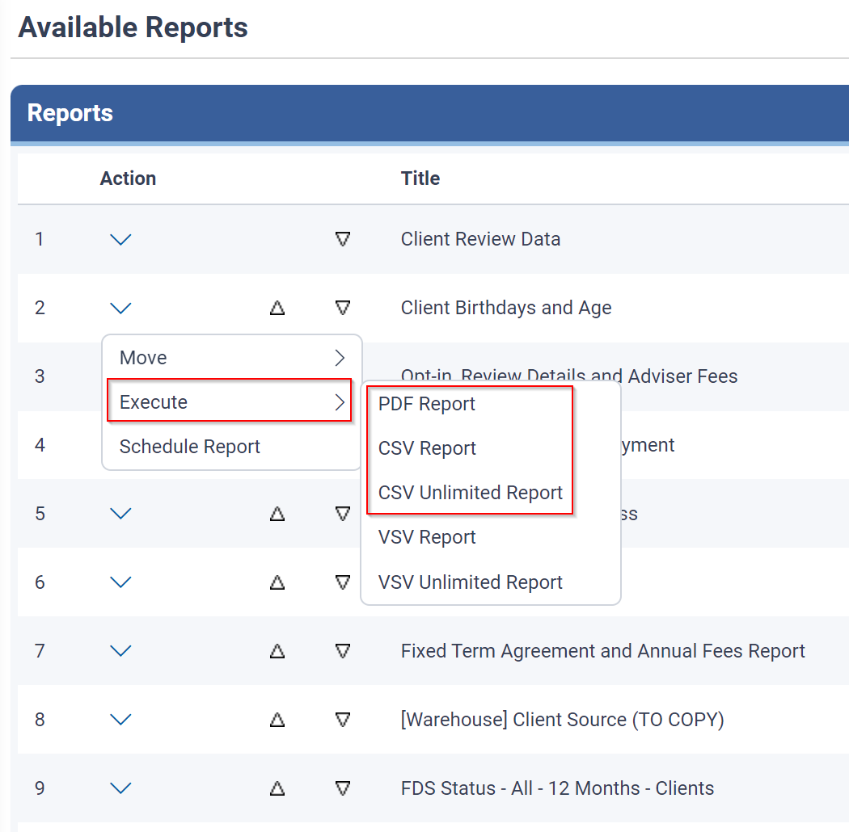
Reports > xport
    To run a report, use the drop-down arrow under actions against the report you wish to run
    Select Execute and choose either PDF Report, CSV Report or CSV Unlimited Report

Slide 29
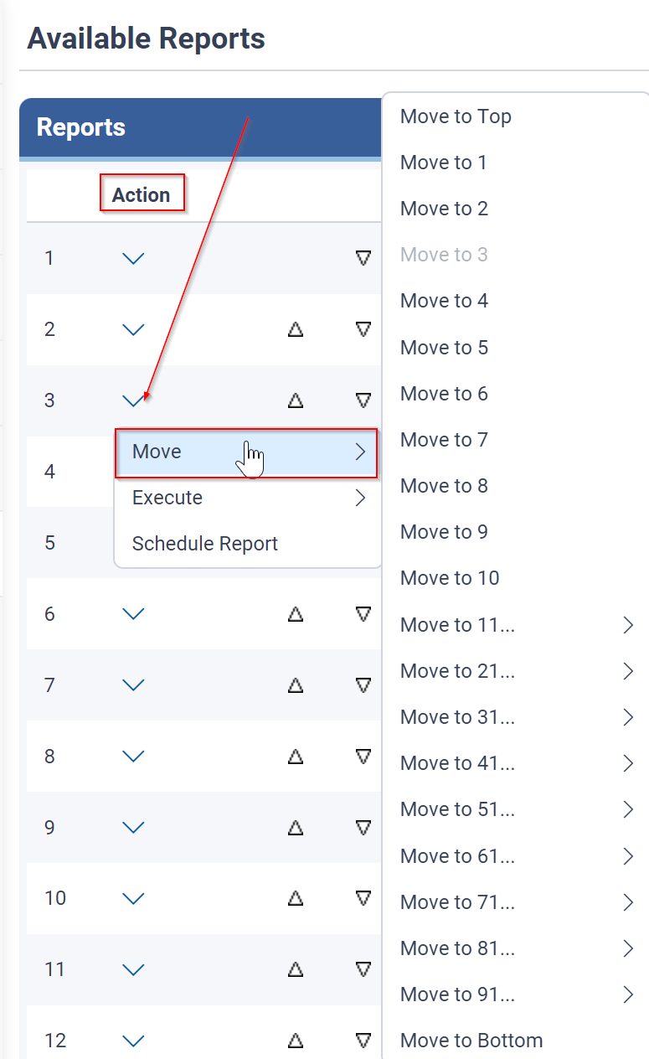
Reports > xport
    The order of Reports visible here are unique to your log on.
    You have the option to Move the report up or down.
    Use the drop-down arrown under the Action column and select Move.

Slide 30
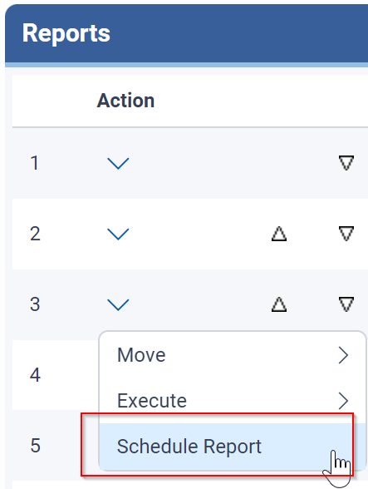
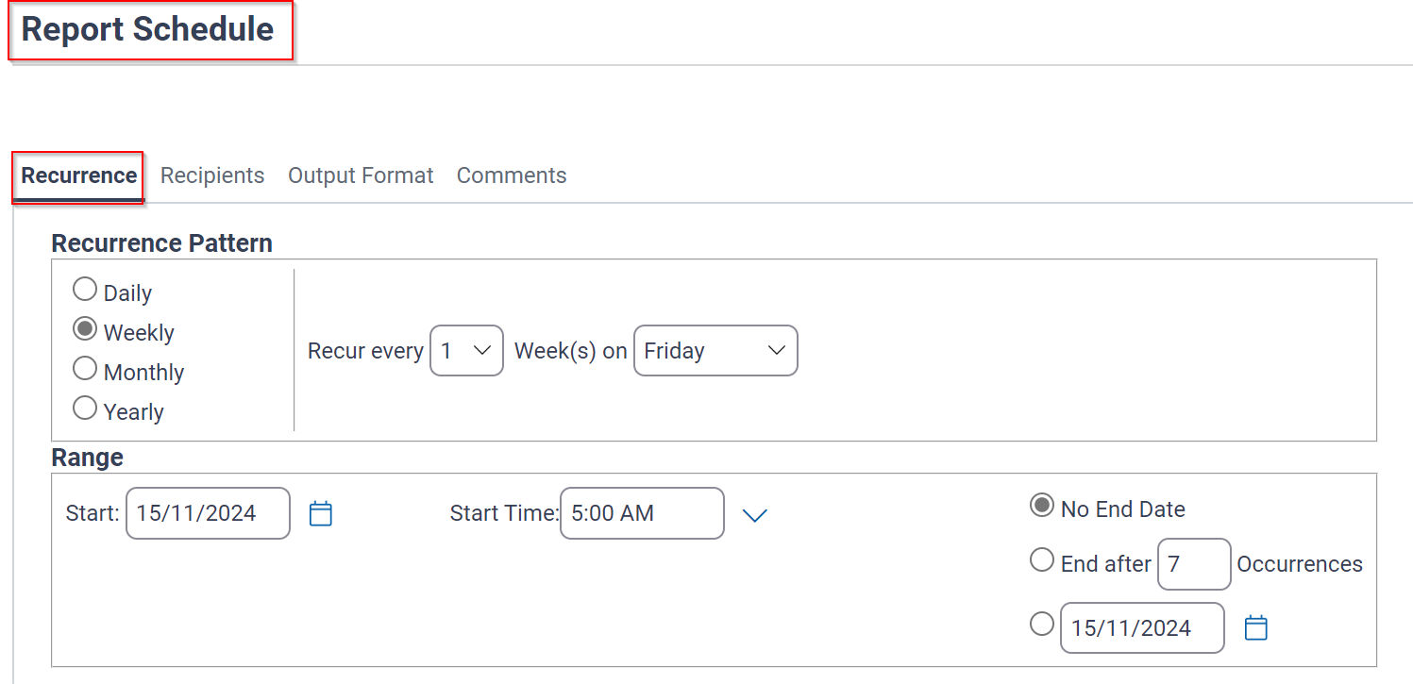
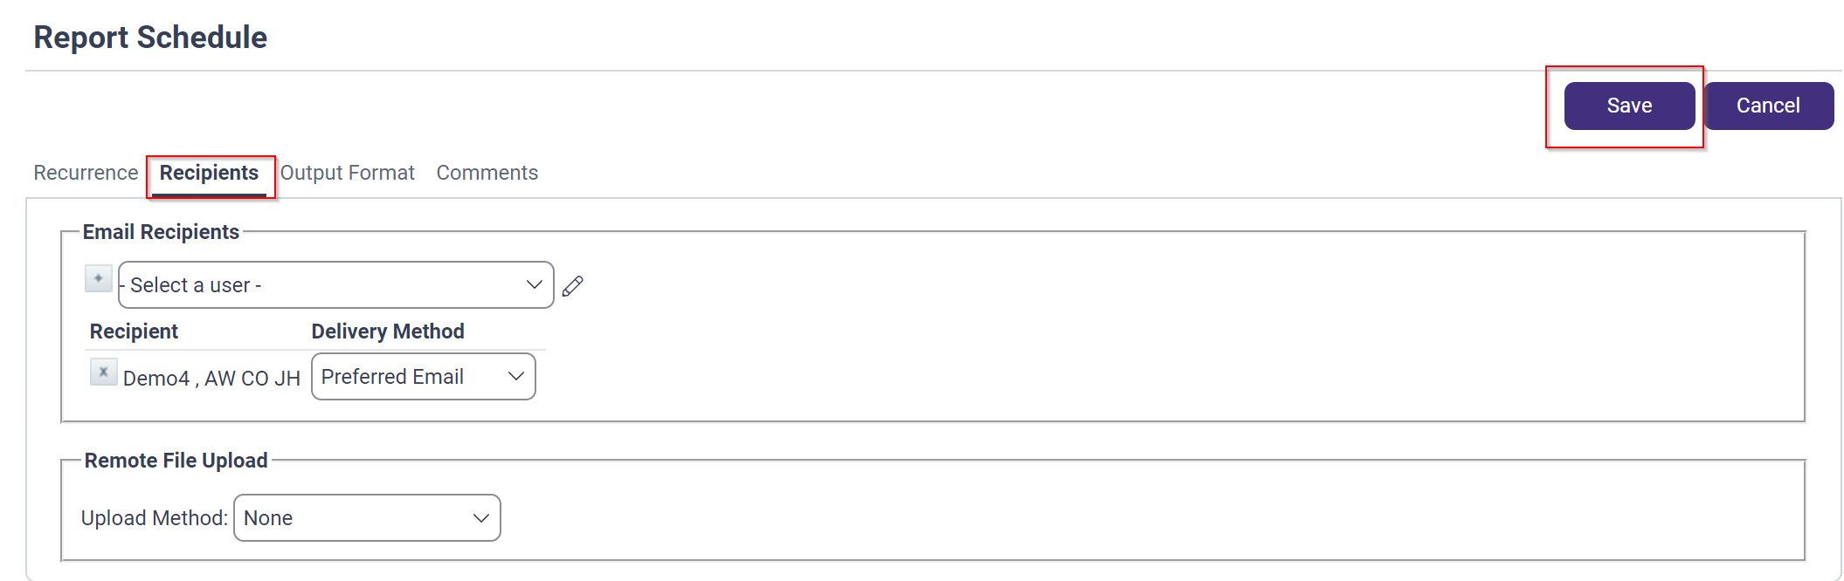
Reports > xport
    Reports can be Scheduled to run later.
    We recommend that large reports be scheduled outside business hours

Slide 31
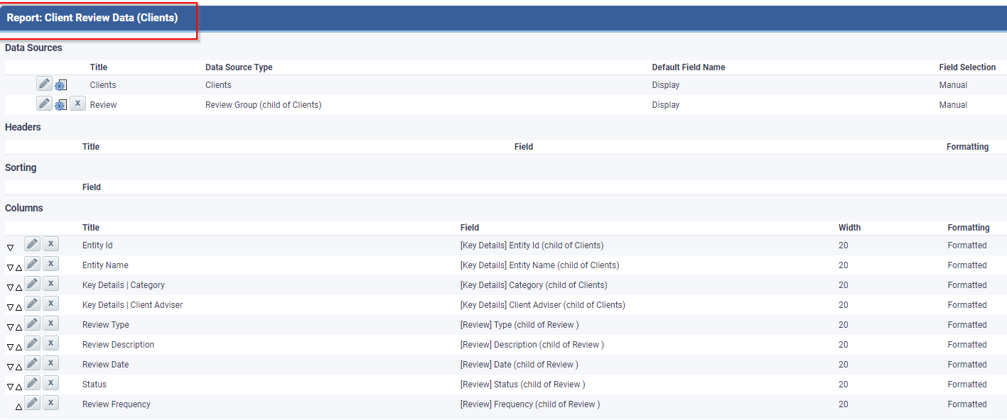
Reports > xport
Xport Reports are more detailed and complex to build

Slide 32
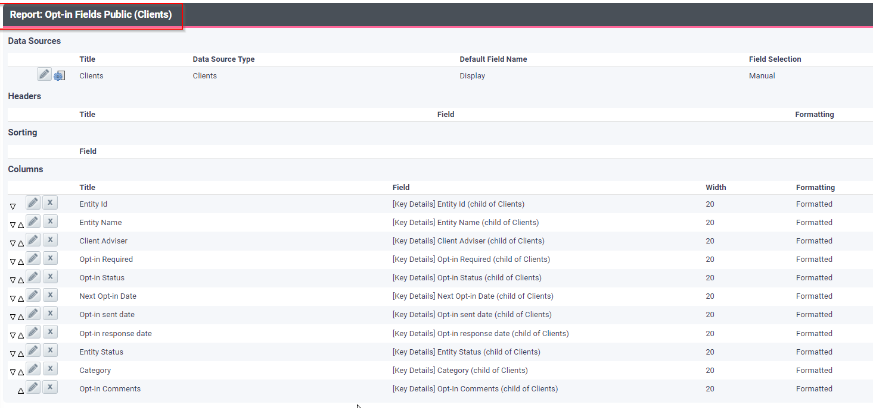
Reports > xport

Slide 33

Tips for Efficient Report Generation
Plan Ahead
  Determine what data you need to include in the report which will help you determine the clients you wish to include.
Automate Reports
  Use Xplan's built-in automation features to schedule reports outside of business hours or at a particular day of the month.
Simplify Data
  Refine your data by using filter options in Client list and narrowing date range.

Slide 34
Review objectives
    You should now be able to:
    Understand when and how to use a Client List
    Understand the different reporting options available and their features
    How to generate the different reports
    Xplan Training Library | Centrepoint Alliance Technology Solutions
    Site: Compass Site: CWT
    Email: compass.support@cpal.com.au Email: cwt@matrixplan.com.au
    Ph: 1300 557 598, option 3, option 1 Ph: 1300 557 598, option 3, option 2

